Slide 1


Product Recommendation in E-commerce
Satyasai Mandlem
XA35174
Notes:
This is a loose template to follow to cover all of the rubric criteria. If you want to change things around, but still meet criteria - you are welcome to. This does not need to be followed to a T.
he questions are there to guide you, do not answer them in a literary way on the PPT, but rather give your bullet notes and talk about these questions as major discussion points in your presentation.

Slide 2
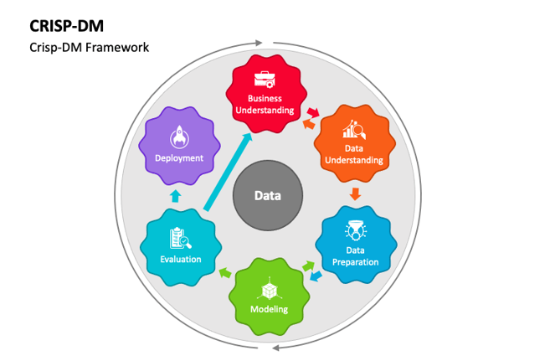
Project Approach

Slide 3
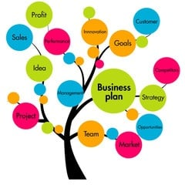
Business Understanding
Business problem:
Increasing Sales
Increasing Customer Satisfaction
Data Source:
The data set used will be the "Online Retail II" data set from UCI Machine Learning Repository (https://archive.ics.uci.edu/ml/datasets/Online+Retail+II).
https://youtu.be/Ip9vno0gqzY

Slide 4

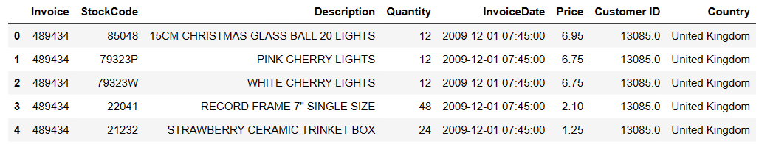
Data Understanding
Attributes
Distribution
Data Missing
Null Values
Outliers

Slide 5
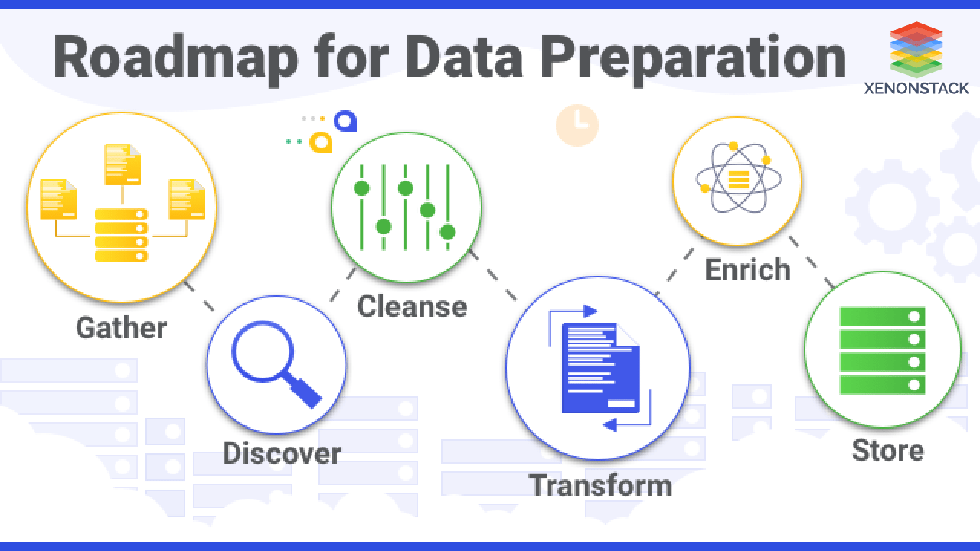
Data preparation
Treating below components
Missing values
Null values
Outliers
Format
Feature Engineering

Slide 6
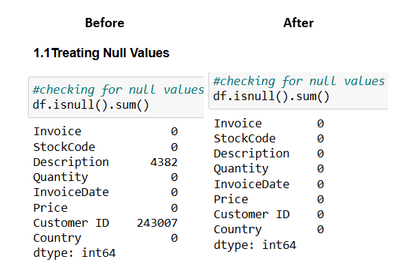
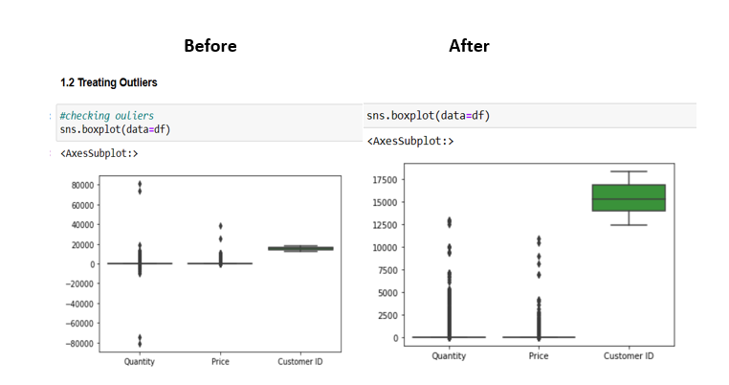
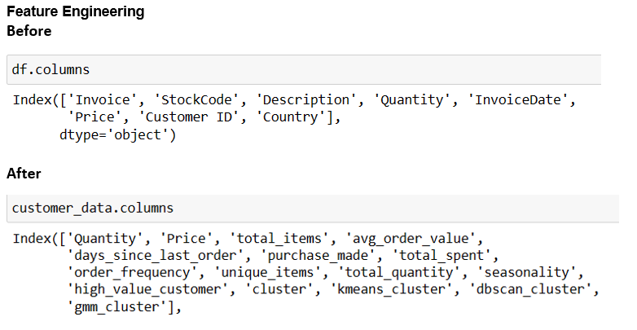
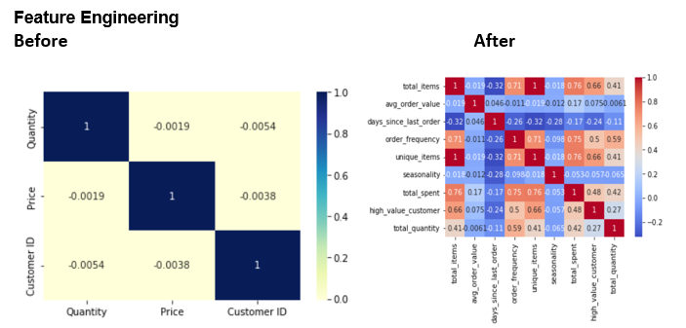
Data preparation

Slide 7
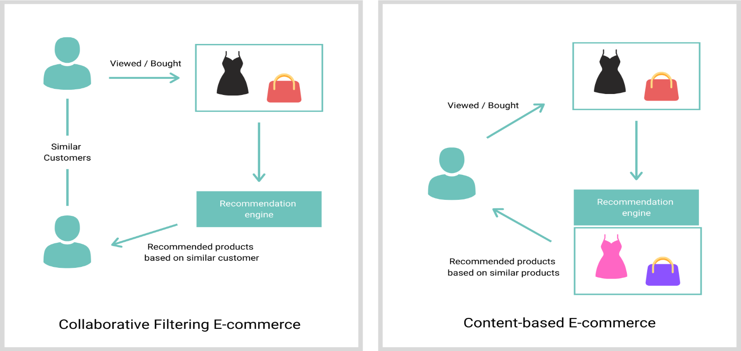
1. The aim of this project is to build a model that can target potential high-value customers with personalized offers and recommendations. 2. To identify groups of customers with similar needs and preferences and provide them with personalized recommendations and offers.
Model Selection

Slide 8

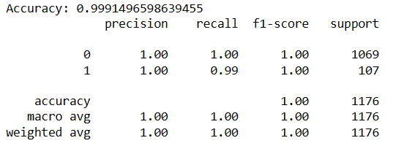

Potential high-value customers with personalized offers and recommendations
Random Forest Classifier
2. Support Vector Machine (SVM) classifier
3. Logistic Regression

Slide 9
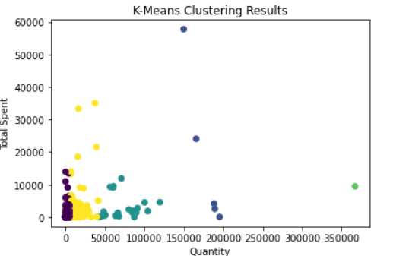
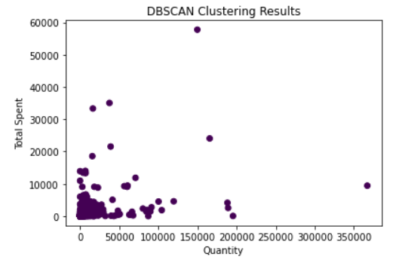
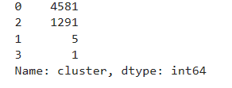
Customers with similar needs and preferences and provide them with personalized recommendations and offers
1. K mean clustering 2. DBSCAN
3. Gaussian Mixture Model

Slide 10
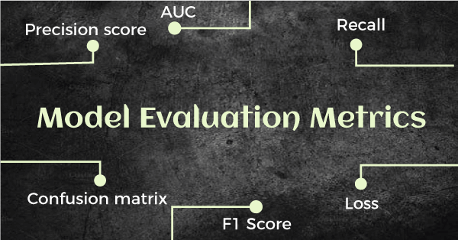
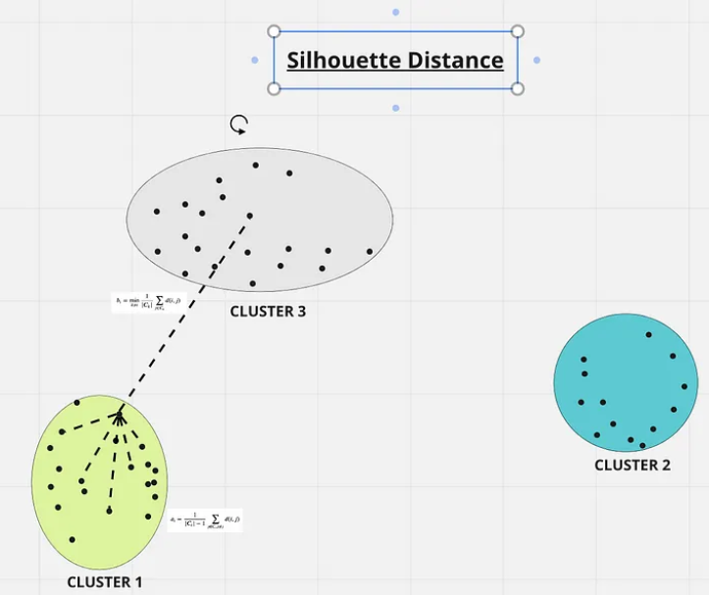
Potential high-value customers with personalized offers and recommendations: Final model is Support Vector Machine (SVM) classifier
Evaluation And Deployment
Customers with similar needs and preferences and provide them with personalized recommendations and offers: Final model is K mean clustering

Slide 11
Thank you

